Slide 1
Predicting Protein Secondary Structure by a Support
Vector Machine Based on a New Coding Scheme
Genome Informatics 15(2): 181–190 (2004)
Long-Hui Wang, Juan Liu, Yan-Fu Li, Huai-Bei Zhou
Presenter: Jun-Shong Lin
Date: August 24, 2006

Slide 2
Abstract
Protein structure prediction is one of the most important problems in modern computational biology. Protein secondary structure prediction is a key step in prediction of protein tertiary structure. There have emerged many methods based on machine learning techniques, such as neural networks (NN) and support vector machine (SVM) etc., to focus on the prediction of the secondary structures. In this paper, a new method was proposed based on SVM. Different from the existing methods, this method takes into account of the physical-chemical properties and structure properties of amino acids. When tested on the most popular dataset CB513, it achieved a Q3 accuracy of 0.7844, which illustrates that it is one of the top range methods for protein of secondary structure prediction.

Slide 3
Introduction
Since 1970s, many approaches for predicting secondary structures from sequences have been developed.
In order to improve the prediction accuracy, two kinds of efforts have been done:
<1>The design of amino acid coding scheme.
<2>The application of machine learning methods.
EX: Neural Network and Support Vector Machine

Slide 4
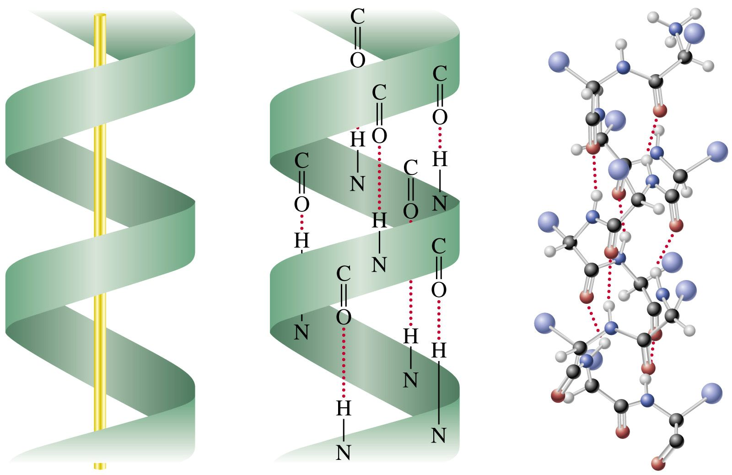
Materials
H(α-helix), G(3₁₀-helix), I(π-helix), E(β-strand), B(isolated β-bridge), T(turn), S(bend) and -(rest).
Helix:
H(α-helix)
G(3₁₀-helix)
I(π-helix)
The helix has 3.6 residues per turn.
The helix has 3.0 residues per turn.
The helix has 4.1 residues per turn.
1
R_{i+1}
H
O
R_{i+3}
R_{i+5}
H
O
H
O
=
=
N
C
C_{a}
N
6
C
C_{a}
=
C_{a}
3
5
9
N
C
2
4
7
8
C_{a}
N
C
C_{a}
N
C
C_{a}
N
C
=
=
=
R_{i}
H
O
O
O
R_{i+2}
H
10
R_{i+4}
H

Slide 5
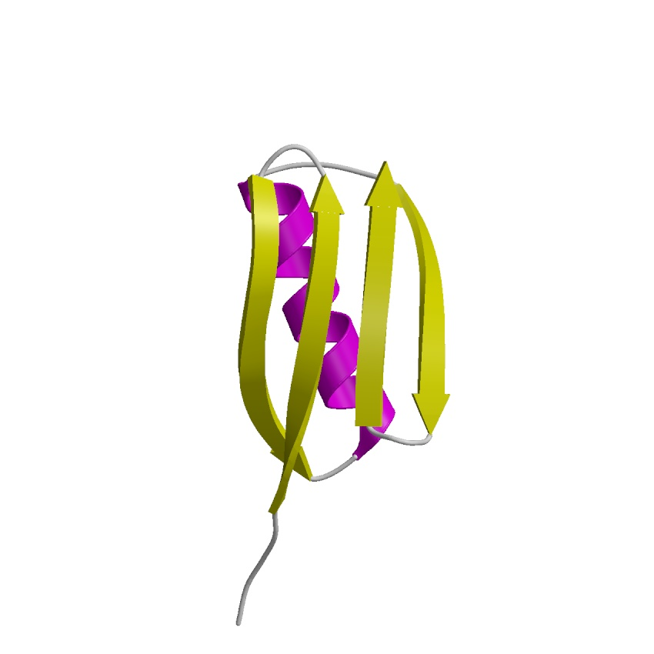
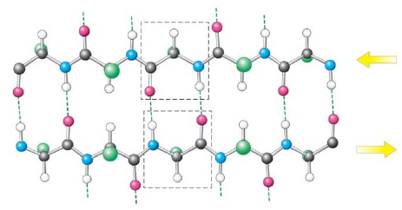
Materials
Strand:
<1>E(β-strand)
<2>B(isolated β-bridge)
Single pair beta-sheet hydrogen bond formation.

Slide 6
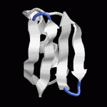
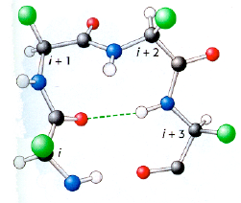
Materials
<1>T(turn)
<2>S(bend)
Local curvature greater than 70 degrees, measured as the angle between alpha carbons at i-2, i, and i+2.
i
i+1
i-1
i-2
i+2
> 70º

Slide 7
Materials
They are usually reduced to three states by one of the following methods:
(1) H, G and I to H; E to E; the rest to C
(2) H, G to H; E, B to E; the rest to C
(3) H, G to H; E to E; the rest to C
(4) H to H; E, B to E; the rest to C
(5) H to H; E to E; the rest to C

Slide 8
Materials
Dataset:
RS126---23,411 residues(31.16% helix, 23.20% sheet, and 45.63% coil.)
CB513---84,034 residues(34.30% helix, 22.54% sheet, and 43.16% coil.)
Training and Testing:
RS126
CB513
1
2
3
4
5
6
7

Slide 9
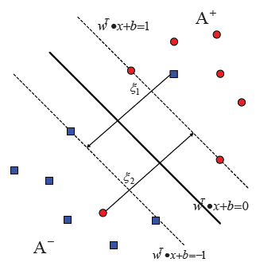

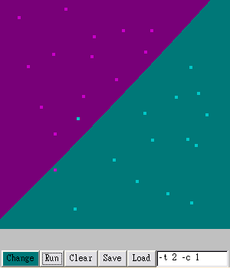
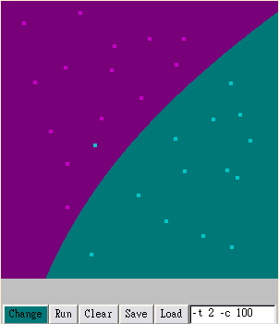
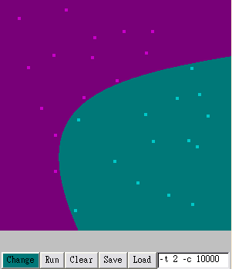
Method
Support Vector Machine(SVM):
The RBF (radial basis function) kernel defined as:
Set parameter γ to 0.10 and the regularization
parameter C to 1.50.
C=1
C=100
C=10000

Slide 10


Method
Prediction Accuracy Assessments:
(1)
Where N is the total number of predicted residues and P_{α} is the number of correctly predicted secondary structures of type α(α -helix).
(2)

Slide 11
Method
A Coding Scheme 1:
The hydrophobic character parameters of the 20 amino acid residues obtained by K-D method are:
I, 4.5; V, 4,2; L, 3.8; F, 2.8;
C, 2.5; M, 1.9; A, 1.8; G, 0.4;
T, −0.7; S, −0.8;W, −0.9; Y, −1.3;
P, −1.6; H, −3.2;E, −3.5; N, −3.5;
Q, −3.5; N, −3.5;K, −3.9; R, 4.0.

Slide 12






Method
A Coding Scheme 2:
We use a 3-dimension vector to code an amino acid.
Example:
Where f_{j} is the score of all of the amino acids residues whose secondary structure is the jth conformation of the 3 types; f_{ij} is the corresponding score of the ith amino acid.
100 residues.
(A:10; H:40; A∩H:6 )
i = A(ALA).
j = H.
P_{AH} =?
f_{AH} = 6 / 10
f_{H} = 40/100
P_{AH} = 1.5

Slide 13
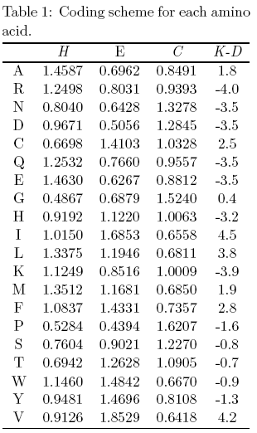
Method
A Coding Scheme 3:
4-dimension vector
P_{ij} > 1: The ith residue
has the propensity to form jth conformation,
P_{ij} < 1:It is likely to form other kinds of conformation.

Slide 14
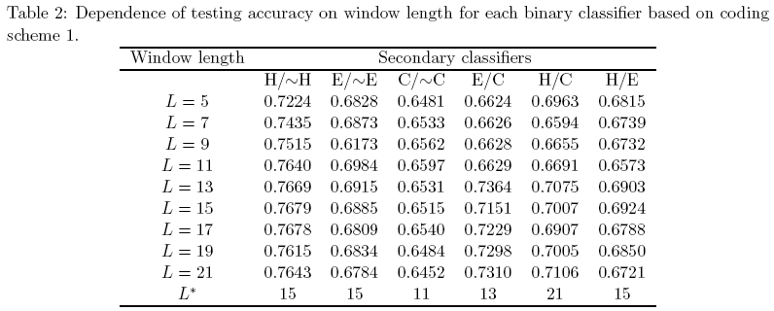
Method
Searching the Optimal Window Length for Binary Classifiers
When the window size is too small, it may lose some important classification information and lead to low prediction accuracy, and a too large window size may suffer from inclusion of unnecessary noise.

Slide 15
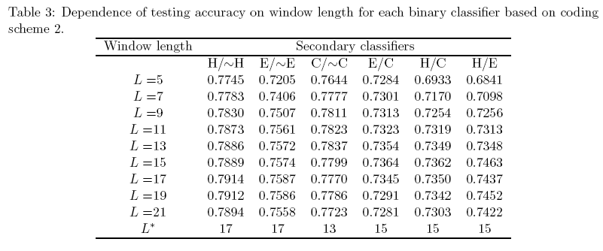
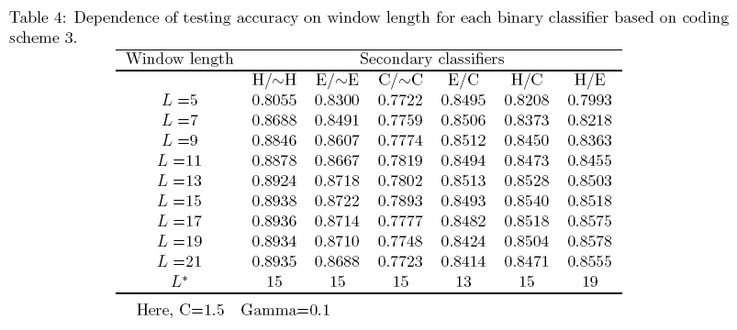
Method

Slide 16
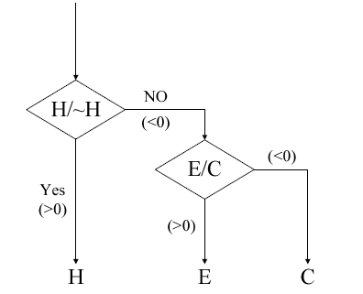
Method
Designing the Tertiary Classifiers
<1>SVM_TREE1 (H/∼H, E/C), SVM_TREE2 (E/∼E, C/H) and SVM_TREE3 (C/∼C,H/E)

Slide 17
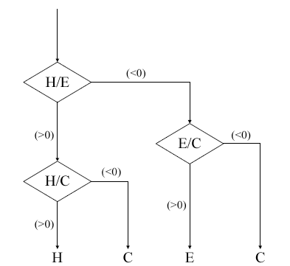
Method
Designing the Tertiary Classifiers
<2>SVM_D1, SVM_D2 and SVM_D3.

Slide 18
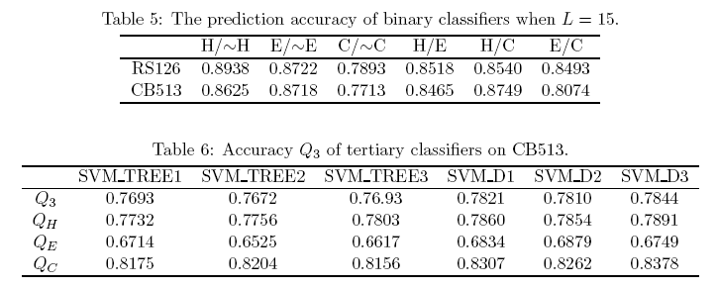
Results
The binary classifiers perform better with coding scheme 3 and window length 15 on RS126.

Slide 19
Conclusions
When quantifying more factors, the dimension of the vector representing amino acid will become larger, which lead to the space complexity increasing.
Since the CB513 dataset was published in 1999, it does not contain the newly published protein structures. The SVM classifiers would also be improved by using larger training sets that contain new protein structures, but it also requires more memory to store data points while obtaining the optimal separating hyperplane.

